Slide 1

Department of Computer Science
Project I’D : 220CSE-PID-56
Project Title : “Advanced TO-DO List”
TEAM DETAILS
SUBMITTED TO :
S.NO. | NAME | BRANCH | ROLL NO.
01. | Vishal Singh | CSE | 2202900100194
02. | Prince Srivastava | CSE | 2202900100140
03. | Prince Sharma | CSE | 2202900100139
Prof. Govind Gupta

Slide 2
PROBLEM STATEMENT
Methodology
In today's fast-paced lifestyle, there's a growing need for technology that’s manage routine efficiently.
1.Creating and maintaining a to-do list can be a powerful tool for personal productivity and organization.
2 .A to-do list is an effective way to organize tasks and boost productivity. It provides a visual representation of what needs to be done, helping to prioritize and manage time efficiently.
Here's a condensed version of the methodology for managing a to-do list:
Define your goals and objectives.
Collect and list all tasks.
Categorize, prioritize, and set deadlines.
Use the right tools (paper, digital apps, etc.
Create daily/weekly to-do lists.
Set SMART goals for each task.
Time block tasks in your schedule.
Regularly review and adjust your lists.
Focus on one task at a time.
Learn from completed to-do lists.

Slide 3
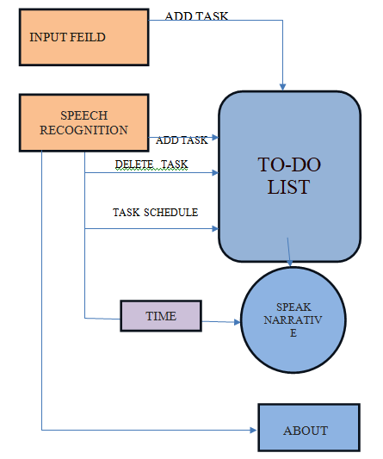
PROBLEM STATEMENT : In today's fast-paced world, we require a Efficient Task Management Tool to manage our day to day life. Our daily routine should be clear to achieve success and for that a online Routine management tool is Required!
MODULES REQUIRED
WORKFLOW
About
To DO
Search Input
AI Narrative
Speech Recognition

Slide 4
Hardware and Software use
(A)HARDWARE
RAM: 8.00GB
Operating System: Windows 11
Hard Disk: 256GB
(B) SOFTWARE:
Visual Studio Code, also commonly referred to as VS Code, is a source-code editor made by Microsoft with the Electron Framework, for Windows, Linux and macOS. Features include support for debugging, syntax highlighting, intelligent code completion, snippets, code refactoring, and embedded Git.

Slide 5



Technology Used
React.js :
It is commonly referred to as react, is an open-source Java script library for building user interfaces (UIs). Developed and maintained by Facebook and a community of developers, React has gained significant popularity for its performance, flexibility, and reusability. Here are some key points about React.js
Tailwind CSS :
It is a popular utility-first CSS framework that simplifies and speeds up the process of building responsive and customizable web interfaces.
Toaster Notification :
It is a popular library used in React applications to display non-intrusive notifications to users.
React-Speech-Recognition :
It allows you to easily incorporate speech recognition features into your React components.

Slide 6

UNIQUENESS
This app is working with your voice command.
You can easily Insert , delete , check schedule with your voice commands.
Notification alarm is set on your command.
The voice you delivered is recognized by an AI.
Information Overload: In today's fast-paced world, individuals are bombarded with a constant stream of information, tasks, and responsibilities. It's easy to feel overwhelmed and forget important tasks.
Lack of Organization: Without a structured approach, people may struggle to organize their tasks, leading to missed deadlines, duplicated efforts, and increased stress.
Poor Time Management: Inefficient time management can result in procrastination, missed opportunities, and difficulty in achieving long-term goals.

